Slide 1
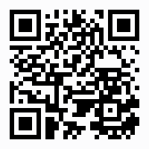
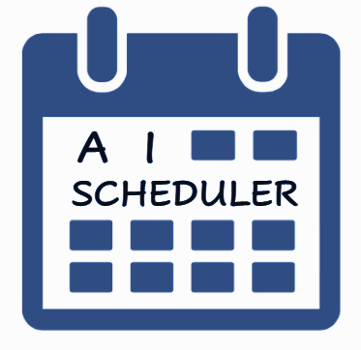
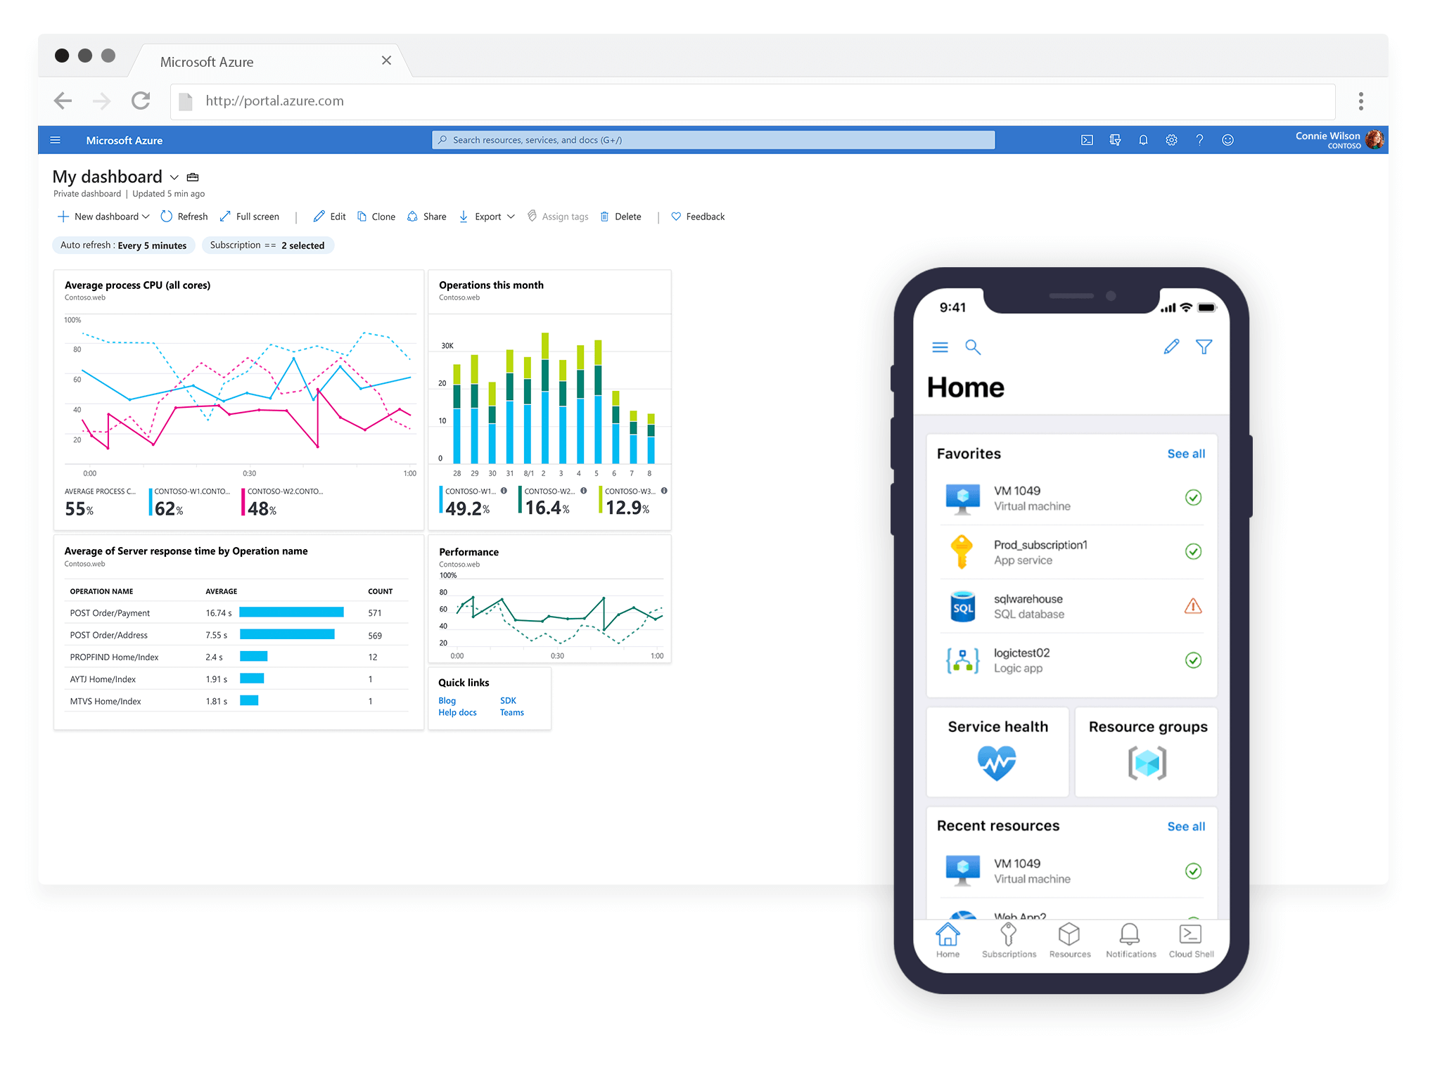


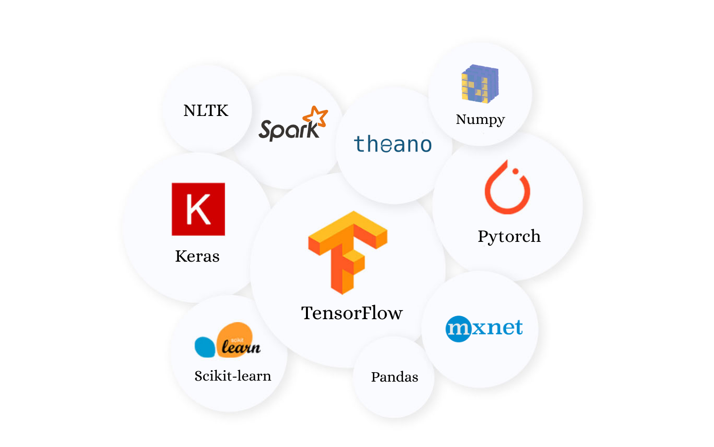







[Poster Describe Research or Software Development Project]
Amit Bibi (203262647) Moran Oshia (3132929633) Alex Chagan (206262123) Instructed by Dr.Elad Horev
Logo
AI - SCHEDULER
Contribution/project goal
Our AI Scheduler will provide an easy way to create a shifts board for the managers and the workers.
Introduction
The AI-Scheduler system will analyze all essential data and will automatically build shift schedules for every worker. Unlike other systems, our system uses a machine learning algorithm which suggests schedule shift offers based on previous preferences of the workers. Our product allows users to maximize efficiency of creating adapted work. schedules with a click of a single button and offers a user friendly interface for both managers and workers.
Selected Approach & Infrastructure
We created a Linux virtual machine in Azure portal with a network security group that regulates the inbound and outbound traffic. In the VM we have a docker container that keeps our web application running.
We use a machine learning algorithm to extract data of previous preferences of workers and creates a recommendation system for each worker.
We use HTML web to offer and submit shifts to users, than we extract data into Excel files, execute a heuristic algorithm and returns output in csv format that keep all the information
and display it to the users.
Our Solution
Build a website that manager can able to create a shift schedule. The part that responsible for the creation of the board shift will use a Linear Programing, that will Schedule Workers to shifts by his preference. In addition, the worker will get a suggestion of schedule shift offers based on previous preferences, the machine will recognize the most frequent shifts the worker chose every week from our DB and set his preference shiftboard.
Technologies and Environments
https://github.com/amitbb93/AI-Scheduler

